Slide 1
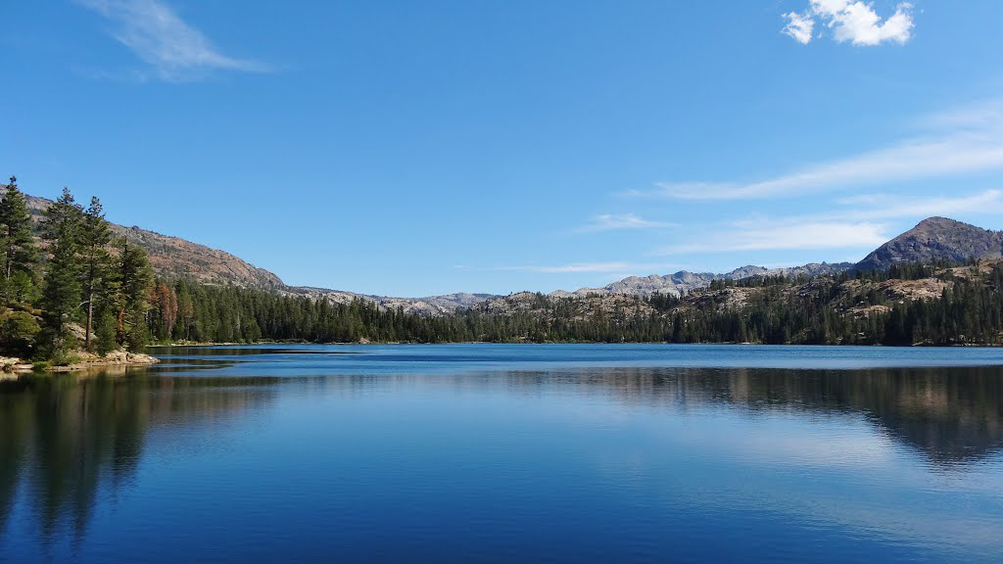
Nevada Irrigation District Water Supply Update March 23, 2022
Proudly serving portions of Nevada, Placer, and Yuba Counties

Slide 2
BOWMAN LAKE PRECIPITATION

Slide 3
NID SNOW SURVEY MARCH 1, 2022 WATER CONTENT

Slide 4
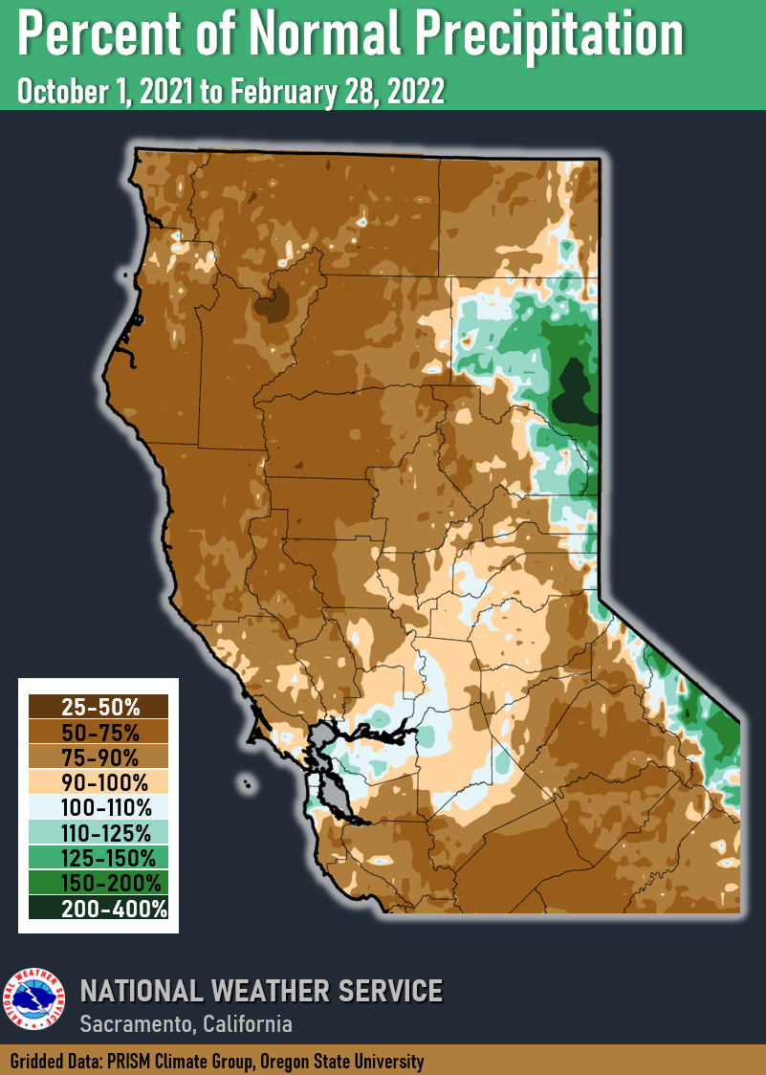

Slide 5
NID RESERVOIR STORAGE

Slide 6
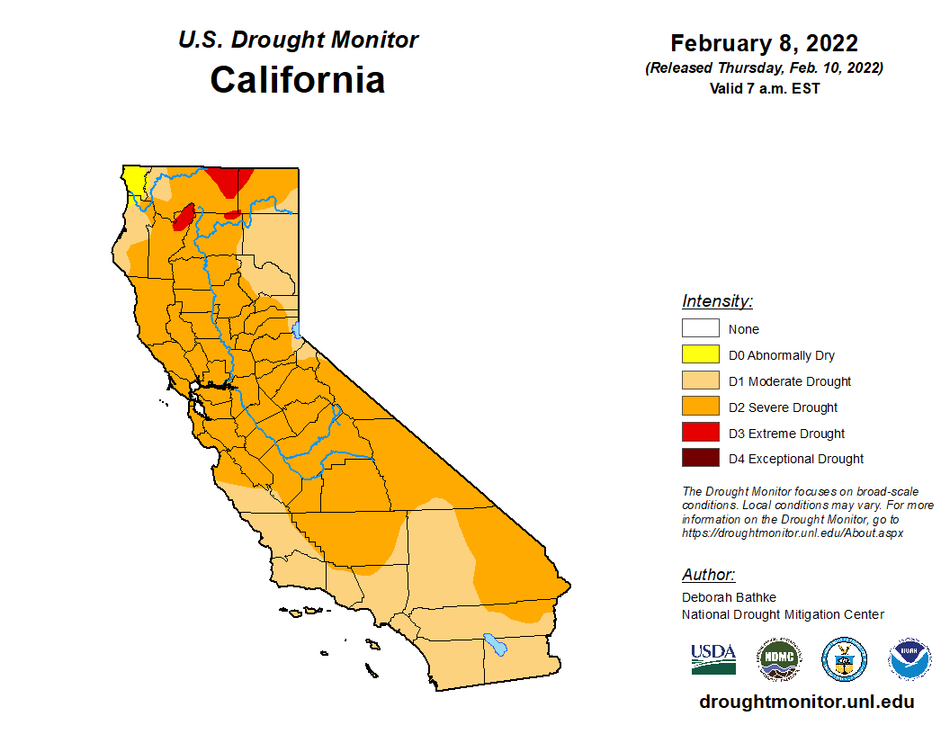

Slide 7
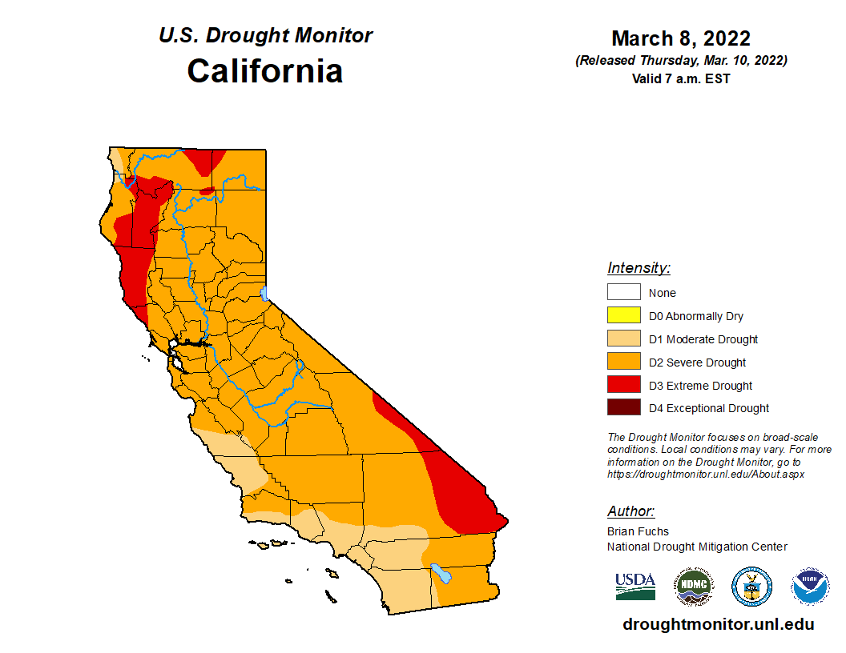

Slide 8
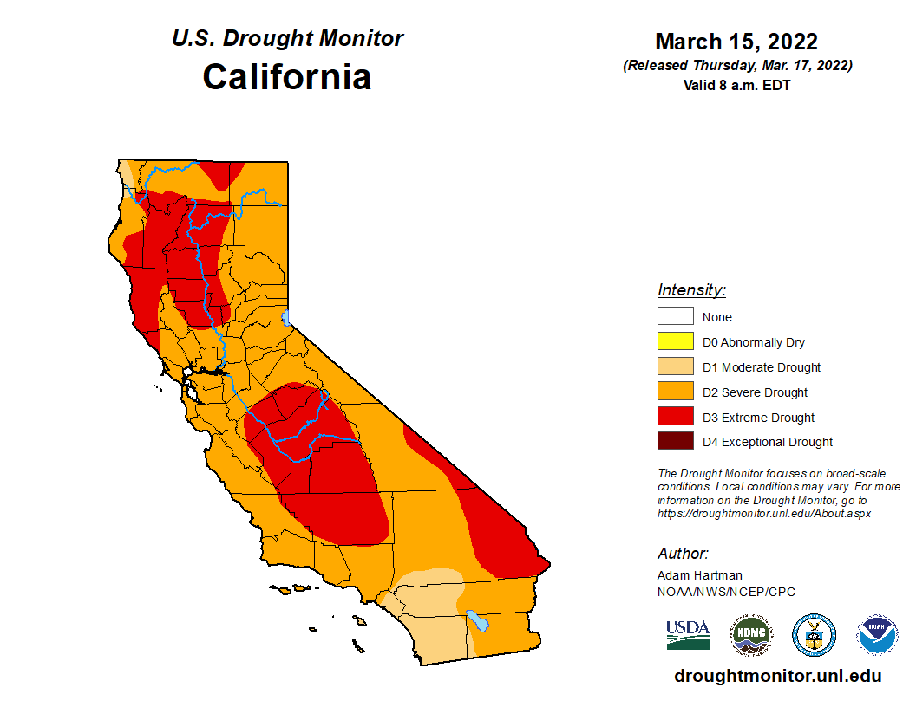

Slide 9
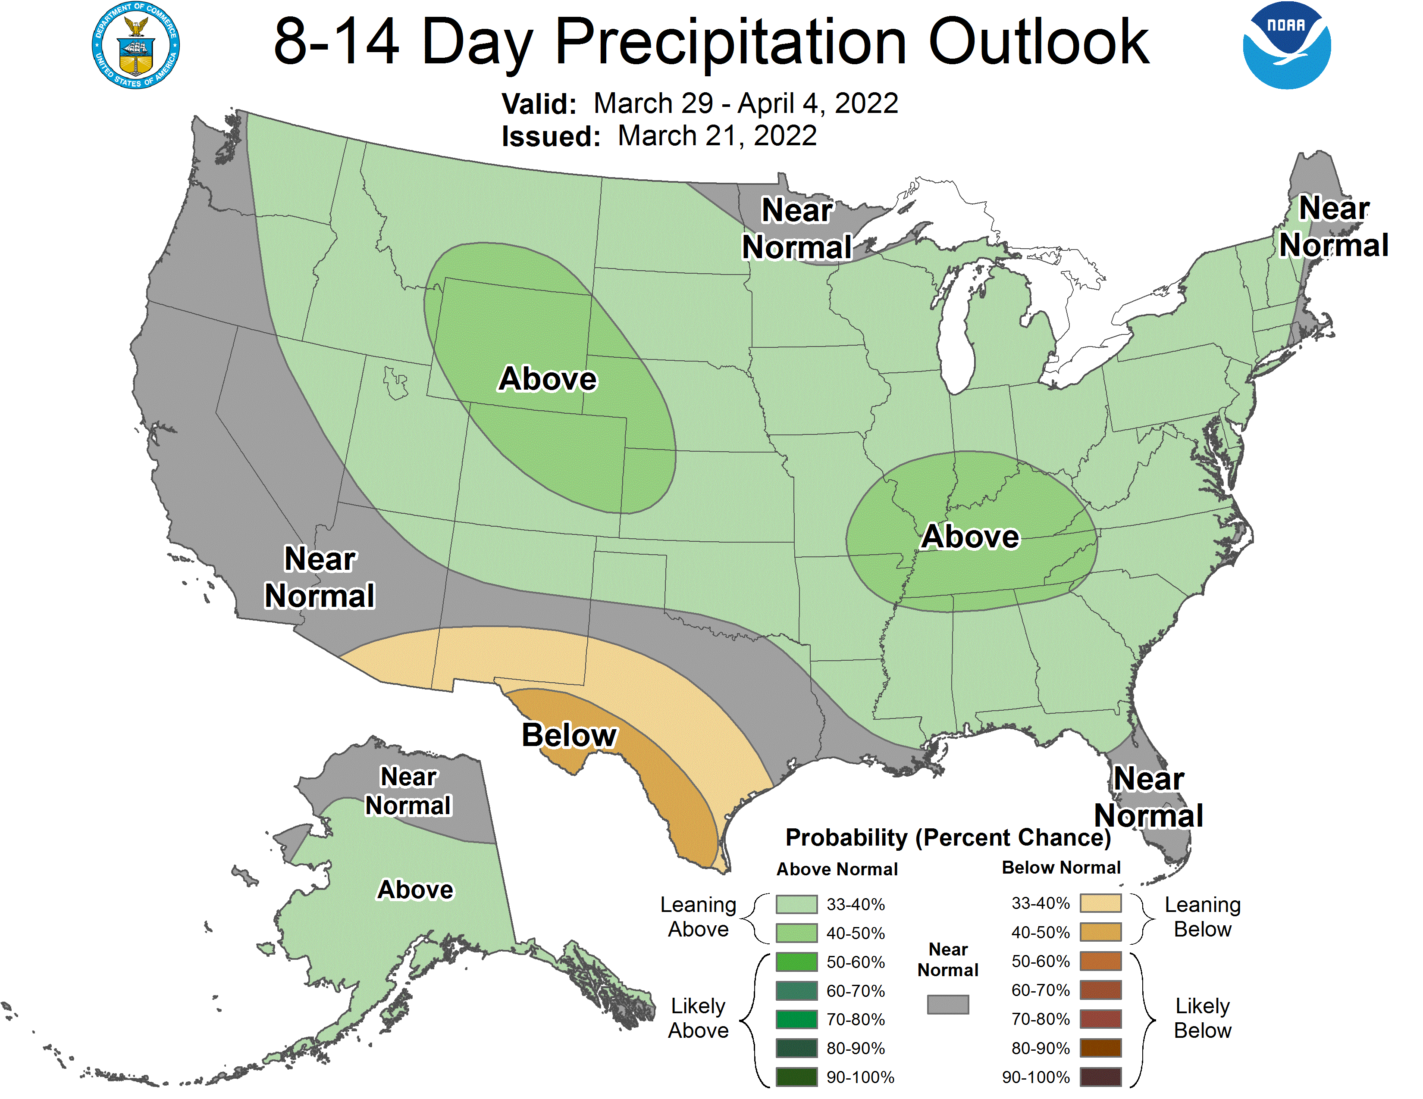

Slide 10
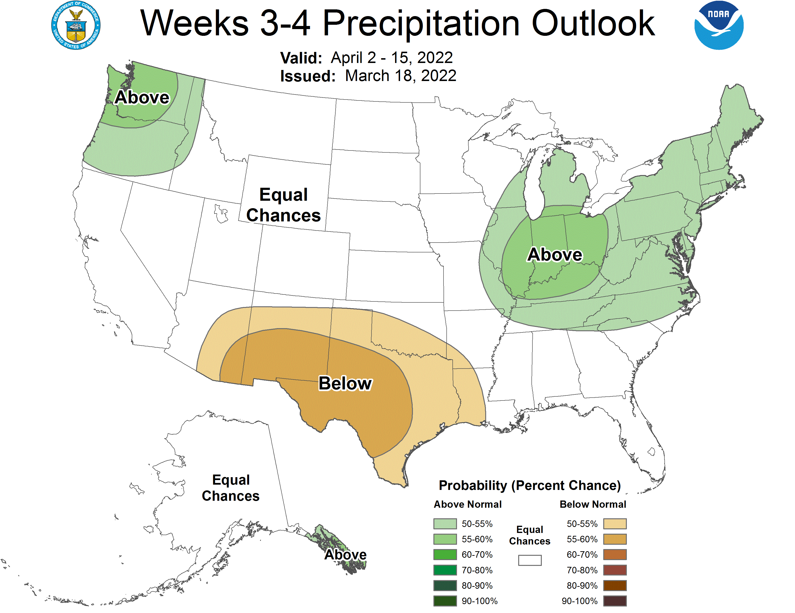

Slide 11
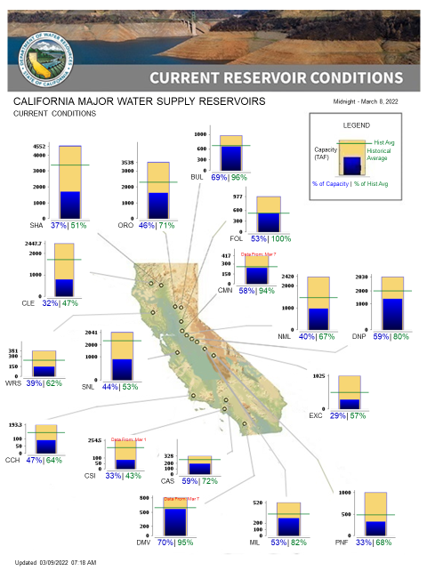

Slide 12
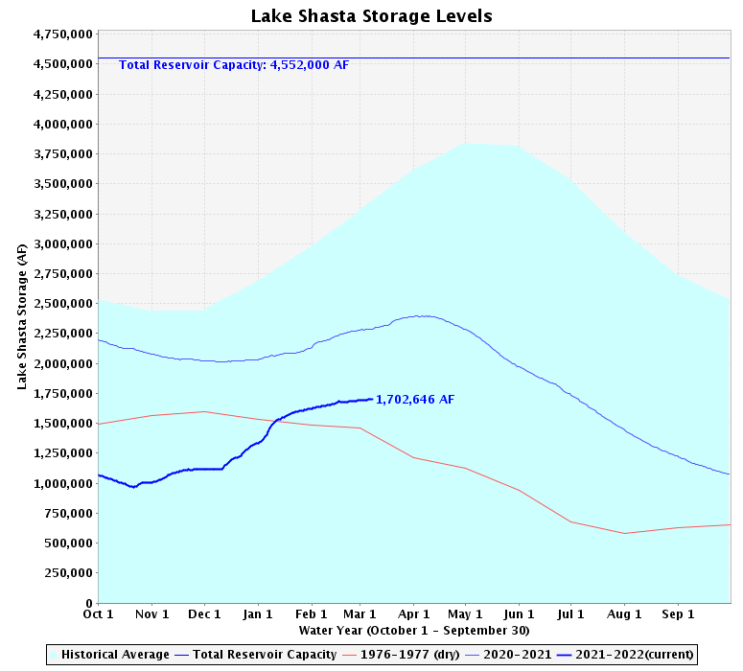

Slide 13
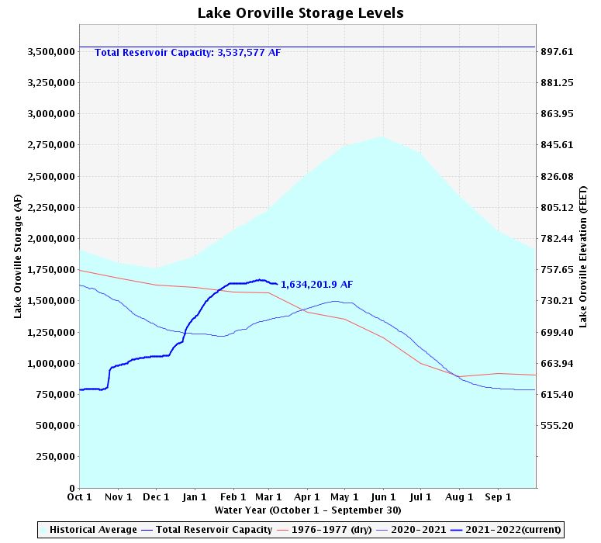

Slide 14
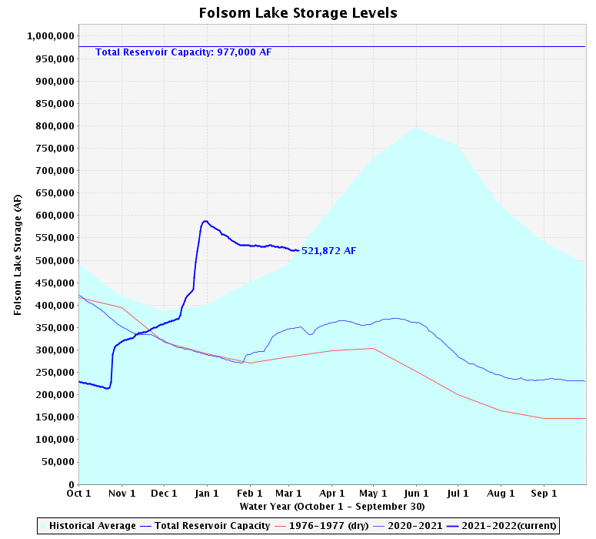

Slide 15
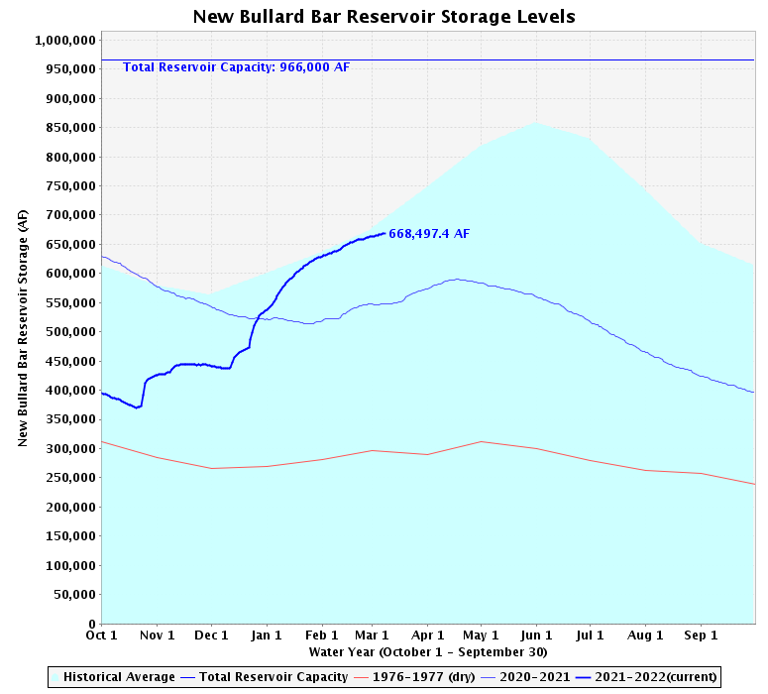

Slide 17
Summary
NID Remains in Stage 1 Drought
Asking for 10% reductions on all water use
Irrigation customers who voluntarily reduced last year will start this year at the reduced amount
Can call into Customer Service if this is a problem
Irrigation customers that voluntarily reduce will reserve their right to return to previous allotments after drought
Standard rates in affect
Fees increases authorized last year have led to high call volume
Full allotment of PG&E water will be purchased (built into the 2022 budget)
State sent notifications of new and increased drought actions coming soon
Staff will return after April snow survey with detailed forecast

