Slide 1
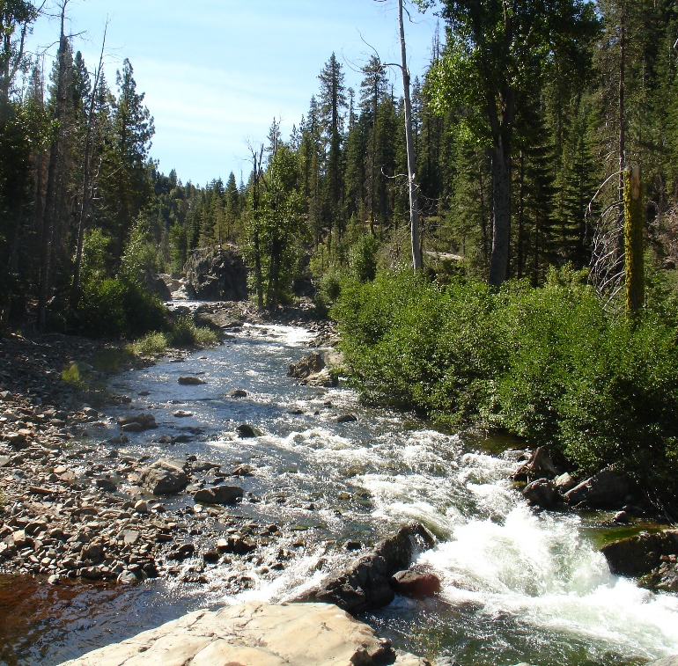
Water Demand Model Update Technical Memorandum (TM)

Slide 2
01 | 2020 Demand Model Update: Goals and Objectives
02 | NID’s Previous Demand Model
 | Approach Model Framework
03 | 2020 Demand Model
 | Updates Model Results
04 | Conclusions

Slide 3
01 2020 Demand Model Update: Goals and Objectives
Looking Back: Historical analysis of NID’s demands
Looking Forward: Projections for future water usage based on historical data
40 Year planning period (2020 - 2060) to align with DOF datasets
Multiple demand scenarios for future planning
Analysis based on already adopted methodology by District
Stand-alone Technical Memo

Slide 4
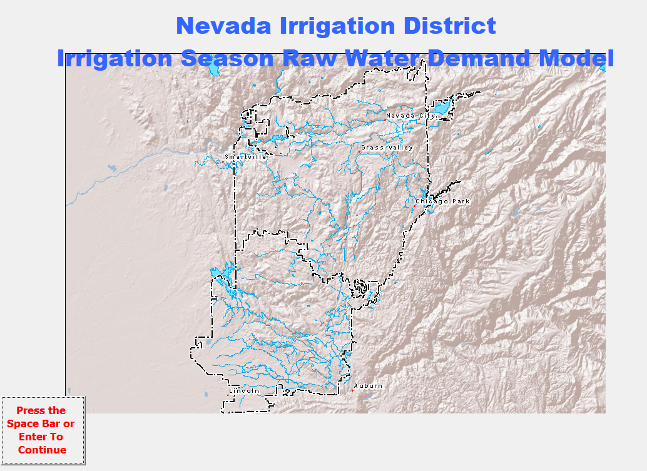
02 NID’s Previous Demand Models
Original Model built by Kleinschmidt Associates as part of Raw Water Master Plan
Phase 1 (2005)
Built in 2005
Based on data through 2002
Projections timeframe 2002-2027
Simple excel based model
Phase 2 (2011)
Update of the prior model by Kleinschmidt Associates (same approach as Phase 1)
Projections based on data through 2007
Projection through 2032
Migration to database model for added functionality

Slide 5
03 2020 Demand Model Approach
Consistent with previous demand models (Phase 1 and Phase 2)
Maximize the use of previous efforts and available data
Update prior models/analyses rather than adopt new analysis approach
Builds on analysis that has been reviewed and adopted by the District
RWMP Phase 1
RWMP Phase 2
Current Demand Model Approach

Slide 6
03 2020 Demand Model: Updates
Migration to MS Access platform and GIS integration
Include model data through 2017
Incorporate updated growth patterns based on DOF data
Update historical water use analysis
Update environmental flows per new FERC licensing agreement
Update mutual water company components

Slide 7
03 2020 Demand Model: Overview

Slide 8
03 2020 Demand Model: Data and Sources
Actual Historical and Current Data Sets
Land Use/Zoning- APN Parcel level data
Historical Billings – NID water customer data (2009 - 2017) both Treated and Agricultural customers
Production/Supply Data – NID treatment plant data
Planning Studies: UWMPs, Agriculture Water Management Plan 2015, 2011census (DOF), regional studies for population and LU trends
Previous Raw Water Master Plan Data 2011
Canal flows – 168 gages
Crop reports
Assumed Data Sets
Unimpaired Hydrology Model

Slide 9
03 2020 Demand Model: Output and Reporting
Model provides 40 -Year planning period projections
Projections by system (Deer Creek and Bear River)
Projections can be queried by canal and segments
Total District estimates
Winter water use estimates

Slide 10
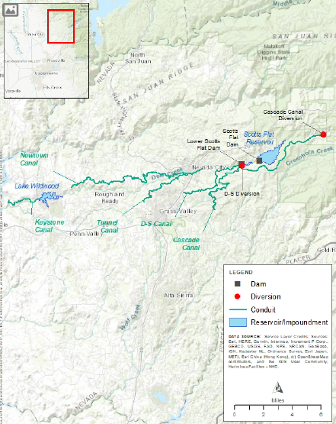
03 2020 Demand Model: Deer Creek System Results
Year | Irrigation Season Demand (Acre-Feet) | Winter Season Demand (Acre-Feet) | Total System Demand (Acre-Feet)
2020 | 37,245 | 15,023 | 52,268
2030 | 43,034 | 15,023 | 58,057
2040 | 48,252 | 15,023 | 63,275
2050 | 53,822 | 15,023 | 68,845
2060 | 60,134 | 15,023 | 75,157

Slide 11
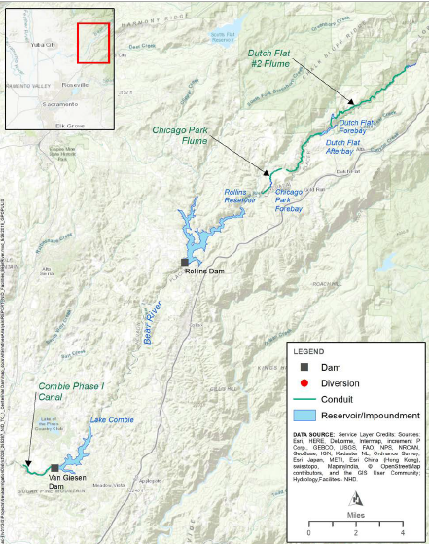
03 2020 Demand Model: Bear River System Results
Year | Irrigation Season Demand (Acre-Feet) | Winter Season Demand (Acre-Feet) | Total System Demand (Acre-Feet)
2020 | 72,839 | 25,355 | 98,194
2030 | 83,244 | 25,355 | 108,599
2040 | 93,455 | 25,355 | 118,810
2050 | 100,910 | 25,355 | 126,265
2060 | 108,424 | 25,355 | 133,779

Slide 12
03 2020 Demand Model: Overall System Results
Year | Total System Demand Dry Year (Acre-Feet) | Total System Demand Wet Year (Acre-Feet)
2020 | 178,362 | 210,262
2030 | 194,557 | 226,457
2040 | 209,985 | 241,885
2050 | 223,010 | 254,910
2060 | 236,836 | 268,736

Slide 13
04 Conclusion
2020 Demand model is based on (and consistent with) updates to Phase 1 and Phase 2 of the District’s Raw Water Master Plan
Model provides demand projection estimates for a 40-Year planning horizon based on historical data
Analysis based on already adopted methodology

Slide 14
06 Conclusion
Summary of 2070 5-Year Drought Water Supply
Analysis Variable | Avg. Year | Hypothetical 5-Year Drought
 |  | 1994 | 1987 | 1988 | 1976 | 1977
Watershed Runoff (ac-ft) | 383,500 | 101,350 | 97,200 | 95,250 | 85,500 | 38,300
Available Carryover Storage (ac-ft) | 87,500 | 87,500 | 25,126 | 1,289 | 0 | 0
Contract Purchases from PG&E (ac-ft) | 7,500 | 37,300 | 31,800 | 30,300 | 27,500 | 26,200
Recycled Water (ac-ft) | 5,300 | 5,300 | 5,300 | 5,300 | 5,300 | 5,300
Total Supply (ac-ft) | 483,800 | 231,450 | 159,426 | 132,139 | 118,300 | 69,800
Environmental Flow Requirement (ac-ft) | 46,200 | 31,100 | 24,700 | 24,000 | 23,200 | 16,400
Total Demand Before Drought Demand Reduction (ac-ft) | 255,136 | 240,036 | 233,636 | 232,936 | 232,136 | 225,336
Drought Action Stage | - | I | IV | IV | IV | IV
Drought Demand Reduction | 0% | 20% | 40% | 50% | 50% | 50%
Total Demand with Drought Demand Reduction (ac-ft) | 255,136 | 206,324 | 158,137 | 132,506 | 127,668 | 120,868
Shortage With Reductions and Contract Purchases (ac-ft) | 0 | 0 | 0 | -367 | -9,368 | -51,068

