Slide 1
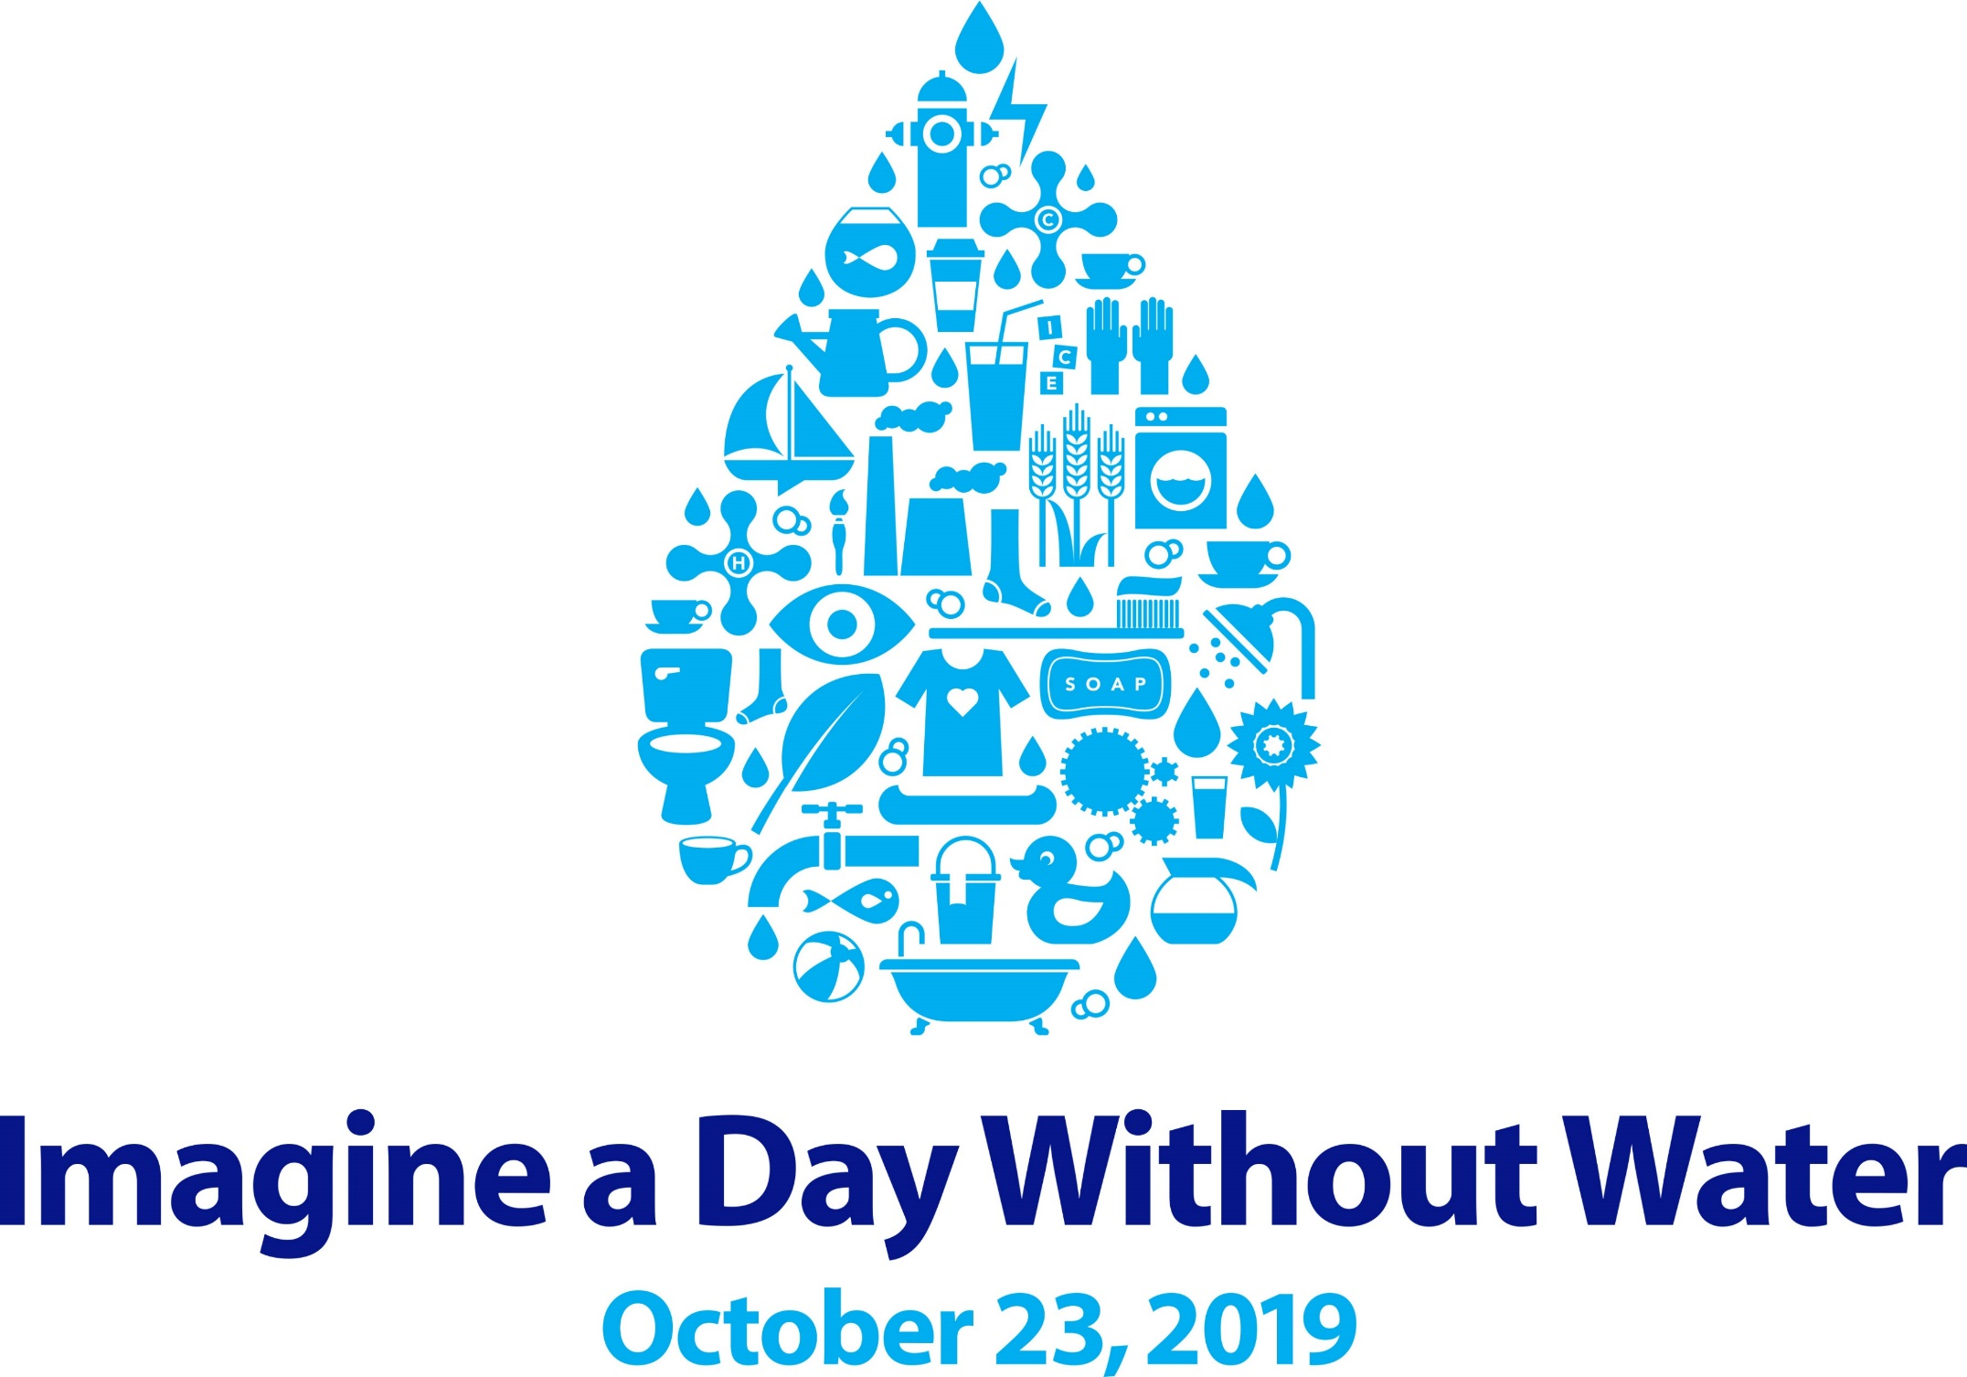

Trivia
thevalueofwater.org

Slide 2

Category
thevalueofwater.org
Notes:
Turn on the tap, and clean water flows out. Flush the toilet, and dirty water goes away. When you have reliable water service, you don’t have to think twice about the infrastructure that brings water to your home or business, and then safely returns water to the environment – but we all should. The reality is, America’s water infrastructure is aging and failing—and there are even communities that have never had access to infrastructure in the first place.
On Imagine a Day Without Water, we ask everyone to consider what their day would be like if they couldn’t turn on the tap and get clean drinking water, or if you flushed the toilet and wastewater didn’t go anywhere. What would that day be like?

Slide 3
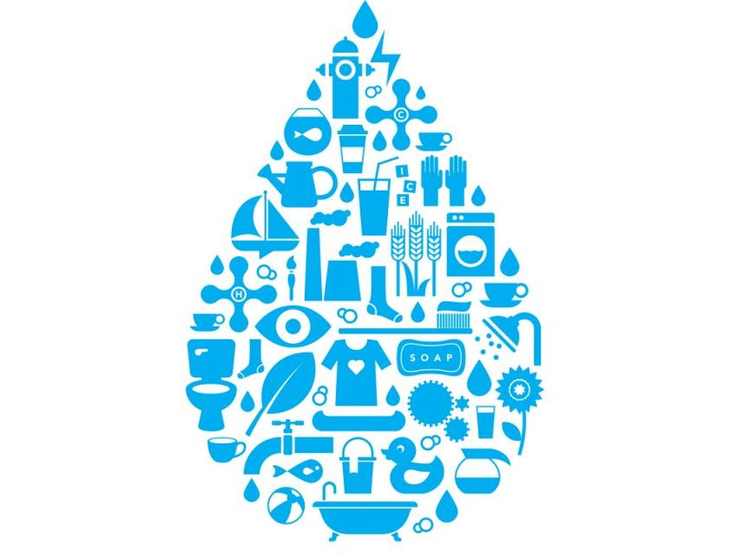
Question
Most of the world’s water is salty or otherwise undrinkable, another 2% is locked in ice caps and glaciers. What percent of the world’s water supply can be used as drinking water?
1%
5%
10%
Antarctica
The Amazon Rainforest
Lake Superior
thevalueofwater.org
thevalueofwater.org
Notes:
Source: https://water.usgs.gov/edu/watercycleice.html

Slide 4
Question
True or false. There is the same amount of water on Earth today as there was when the planet was formed?
True
False
thevalueofwater.org
Notes:
Source: https://sfwater.org/modules/showdocument.aspx?documentid=85
(That’s because water gets continually recycled through the water cycle.)

Slide 5
Question
What are the three states of water during the water cycle? Liquid, vapor and ______.
Plasma
Gel
Ice
thevalueofwater.org
Notes:
Source: https://www.usgs.gov/special-topic/water-science-school/science/water-cycle-schools-and-kids?qt-science_center_objects=0#qt-science_center_objects

Slide 6
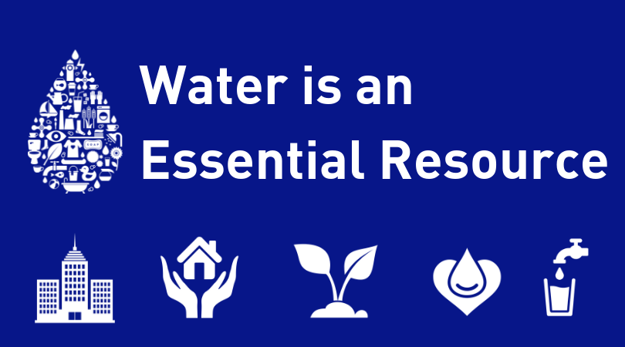
Category
thevalueofwater.org
Notes:
A day without water is a public health and safety crisis.
A day without water means firefighters can’t do their jobs, hospitals would be unsanitary, and no one could wash dirty dishes or clothes.
Living without water is an economic crisis too: a single nationwide day without water service would put $43.5 billion in economic activity at risk.

Slide 7
Question
The average person could live without food for nearly a month. But water is so essential to human life, a person can only survive about ____ week(s) without water.
One
Two
Three
thevalueofwater.org
thevalueofwater.org
Notes:
Source: https://www3.epa.gov/safewater/kids/waterfactsoflife.html

Slide 8
Question
About how many gallons of water does the average American use per day?
20-30
50-60
80-100
thevaleofwater.org
thevalueofwater.org
Notes:
Source: https://water.usgs.gov/edu/qa-home-percapita.html

Slide 9
Question
What is the largest use of household water?
Taking showers and baths
Flushing the toilet
Laundry
thevalueofwater.org
Notes:
Source: https://water.usgs.gov/edu/qa-home-percapita.html

Slide 10
Question
What is the largest use of water in the US?
Irrigation of agriculture
Consumption at homes and businesses
Generating electric power
thevalueofwater.org
Notes:
Source: https://www.watercalculator.org/water-use/the-water-footprint-of-energy/

Slide 11
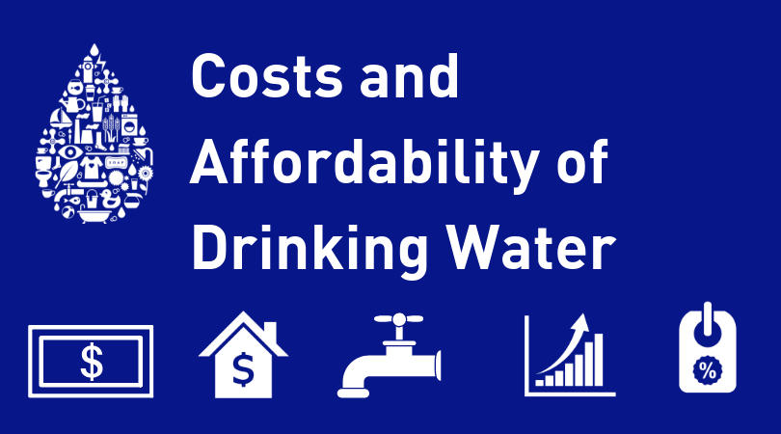
Category
thevalueofwater.org

Slide 12
Question
The average cost for water supplied to a home in the U.S. is about $2.00 for 1,000 gallons, which equals how many gallons for a penny?
One
Three
Five
thevalueofwater.org
Notes:
Source: https://www.seametrics.com/blog/water-facts/

Slide 13
Question
What percent of American voters say what they pay for water service is affordable?
30 percent
50 percent
80 percent
thevalueofwater.org
Notes:
Source: http://thevalueofwater.org/sites/default/files/2019%20VOW%20ONE-PAGER.pdf

Slide 14
Question
True or False: 3 of 5 American voters would be willing to pay a modest increase in local water rates to fund improved service.
True
False
thevalueofwater.org
Notes:
Source: http://thevalueofwater.org/sites/default/files/2019%20VOW%20ONE-PAGER.pdf

Slide 15
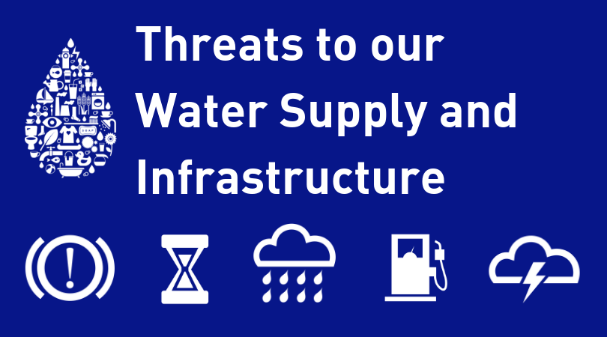
Category
thevalueofwater.org
Notes:
Water infrastructure is the lifelines of our communities.
Our water infrastructure supports every facet of our daily lives, but our water infrastructure is facing unprecedented challenges.
Demographic changes and climate pressures, including natural disasters like droughts, flooding, and wildfires, threaten our infrastructure and increase the possibility of a day without water.
Some communities are grappling with toxic algae blooms and pollution from chemicals or raw sewage, others are facing startling groundwater depletion.
These challenges look different to different communities and will require local solutions, but it’s clear that reinvestment in our water systems must be a national priority.

Slide 16
Question
True or false: Just as water regulates the temperature of the human body, water regulates the Earth’s temperature.
True
False
thevalueofwater.org
Notes:
Source: https://www3.epa.gov/safewater/kids/waterfactsoflife.html

Slide 17
Question
What factors threaten our water supply?
Aging infrastructure/ systems
Climate Change
Growing cities
All of the above
thevalueofwater.org
Notes:
Source: http://thevalueofwater.org/

Slide 18
Question
Name the two main nutrients that pollute our nation’s waterways as a result of agriculture.
Nitrogen and phosphorus
Hydrogen and oxygen
Calcium and magnesium
thevalueofwater.org
Notes:
Source: https://www.nrdc.org/stories/water-pollution-everything-you-need-know#whatis

Slide 19
Question
Global warming occurs when _______, along with other air pollutants and greenhouse gases collect in the atmosphere, absorb sunlight, and heats the planet.
Chlorine
Carbon dioxide
Carbon monoxide
thevalueofwater.org
Notes:
Source: https://www.nrdc.org/stories/global-warming-101#weather

Slide 20
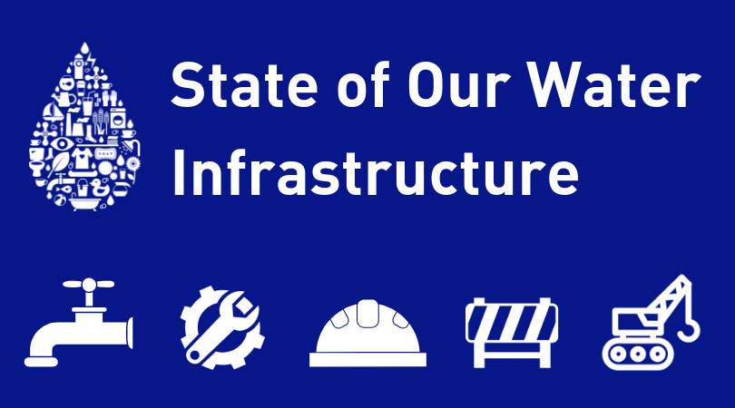
Category
thevalueofwater.org

Slide 21
Question
How often does a water main burst in the US?
Every two minutes
Every two hours
Two times per day
thevalueofwater.org
Notes:
Source: https://www.citylab.com/solutions/2011/12/who-should-pay-aging-water-infrastructure/622/

Slide 22
Question
Every year, ____ gallons of untreated wastewater and stormwater are released into bodies of water across the country.
900,000
900 million
900 billion
thevalueofwater.org
Notes:
Source: https://www.americanrivers.org/threats-solutions/clean-water/sewage-pollution/

Slide 23
Question
Much of the nation’s underground pipes have a lifespan of ___ to ___ years and are now due for replacement.
25 to 50
50 to 75
75 to 100
thevalueofwater.org
Notes:
Source: http://thevalueofwater.org/sites/default/files/Economic%20Impact%20of%20Investing%20in%20Water%20Infrastructure_VOW_FINAL_pages.pdf

Slide 24

Category
thevalueofwater.org

Slide 25
Question
The US is currently funding what proportion of its water infrastructure needs?
One-fourth
One-third
One-half
thevalueofwater.org
Notes:
Source: http://thevalueofwater.org/sites/default/files/Economic%20Impact%20of%20Investing%20in%20Water%20Infrastructure_VOW_FINAL_pages.pdf

Slide 26
Question
From 1977 to 1944 federal contribution to water infrastructure capital spending has declined from 63 percent to _____ percent?
9
29
49
thevalueofwater.org
Notes:
Source: http://thevalueofwater.org/sites/default/files/Economic%20Impact%20of%20Investing%20in%20Water%20Infrastructure_VOW_FINAL_pages.pdf

Slide 27
Question
How much money needs to be invested in water infrastructure over the next 20 years to get to a state of good repair?
$4.8 million
$4.8 billion
$4.8 trillion
thevalueofwater.org
Notes:
Source: https://www.pureblue.org/post/voters-care-about-water-infrastructure

Slide 28
Question
The federal government spends _____ more resources upgrading and maintaining IT infrastructure of federal agencies than it does repairing water systems.
4 times
14 times
24 times
thevalueofwater.org
Notes:
Source: http://thevalueofwater.org/sites/default/files/Economic%20Impact%20of%20Investing%20in%20Water%20Infrastructure_VOW_FINAL_pages.pdf

Slide 29
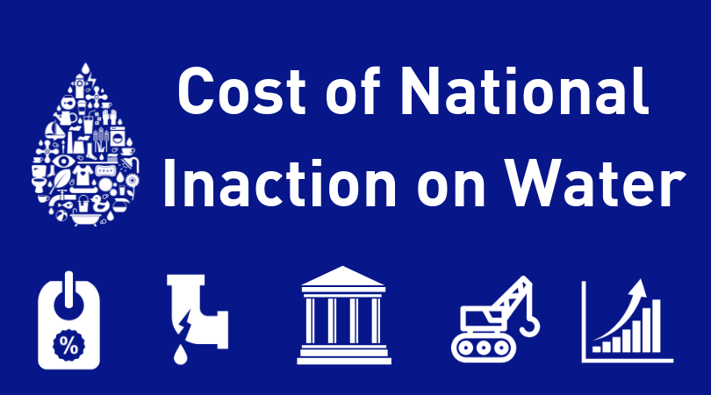
Category
thevalueofwater.org

Slide 30
Question
A one-day national disruption in water service would cause a loss of _____ in national GDP?
$22.5 billion
$2.25 billion
$22.5 million
thevalueofwater.org
Notes:
Source: http://thevalueofwater.org/sites/default/files/Economic%20Impact%20of%20Investing%20in%20Water%20Infrastructure_VOW_FINAL_pages.pdf

Slide 31
Question
What percentage of Americans support a proactive program of water upgrades rather than waiting for systems to fail?
55
65
75
thevalueofwater.org
Notes:
Source: http://thevalueofwater.org/sites/default/files/To%20share%20website%20-%202018%20VOW%20Poll%20Results.pdf

Slide 32
Question
What percent of Americans support increasing federal investment to rebuild our water infrastructure?
62
88
94
thevalueofwater.org
Notes:
Source: http://thevalueofwater.org/sites/default/files/To%20share%20website%20-%202018%20VOW%20Poll%20Results.pdf

Slide 33

Category
thevalueofwater.org

Slide 34
Question
How much money would be generated in economic activity by funding the annual water infrastructure investment need?
$220 million
$2.2 billion
$220 billion
thevalueofwater.org
Notes:
Source: http://thevalueofwater.org/sites/default/files/Economic%20Impact%20of%20Investing%20in%20Water%20Infrastructure_VOW_FINAL_pages.pdf

Slide 35
Question
Closing the national water infrastructure investment gap would create how many American jobs?
130,000
1.3 million
13 million
thevalueofwater.org
Notes:
Source: http://thevalueofwater.org/sites/default/files/Economic%20Impact%20of%20Investing%20in%20Water%20Infrastructure_VOW_FINAL_pages.pdf

Slide 36
Question
Employment opportunities in water infrastructure sectors provide a wage that is ____ above the national average.
20 percent
25 percent
30 percent
thevalueofwater.org
Notes:
Source: http://thevalueofwater.org/sites/default/files/Economic%20Impact%20of%20Investing%20in%20Water%20Infrastructure_VOW_FINAL_pages.pdf

Slide 37
Question
The number of jobs supported annually by funding the water infrastructure gap would be greater than the employed workforce in how many states?
6
16
26
thevalueofwater.org
Notes:
Source: http://thevalueofwater.org/sites/default/files/Economic%20Impact%20of%20Investing%20in%20Water%20Infrastructure_VOW_FINAL_pages.pdf

Slide 38

Thanks for Participating!
thevalueofwater.org
Notes:
Strong leadership on water is key to securing our future.
Imagine a Day Without Water is an opportunity to share why water is important to you, your business, your community.
We can speak out together, with one voice, and ask public officials at every level of government to take responsibility for our water today and tomorrow.
We can help secure a better future for the millions of Americans who don’t have reliable water service today and ensure a reliable water future for generations to come.
Investing in our water is investing in a future where no American will have to imagine a day without water.

